Slide 1
Brownfields 101
MDEQ Brownfield
Redevelopment
Program

Slide 2
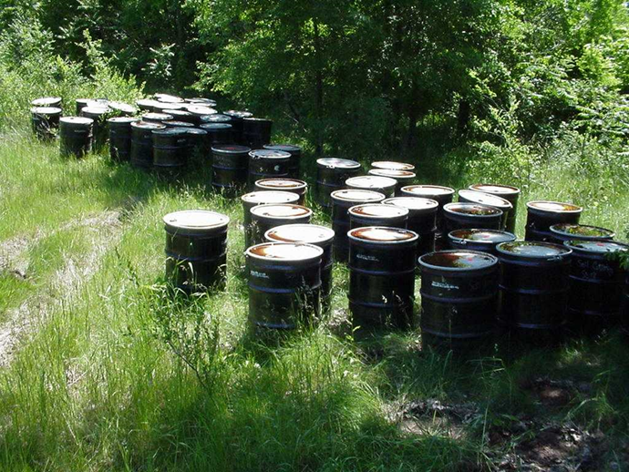
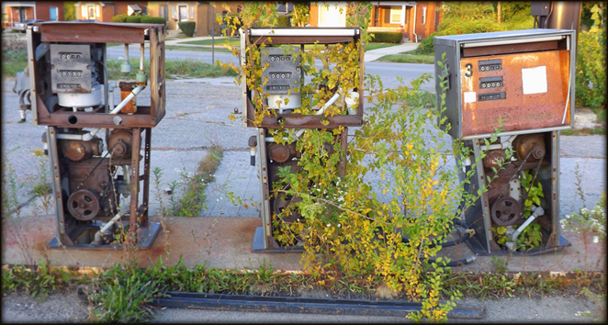
What is a brownfield?
A piece of property that is known to be contaminated
Or suspected to be contaminated based on prior use
Notes:
Carrie

Slide 3
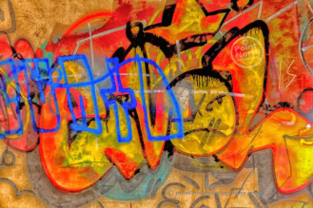
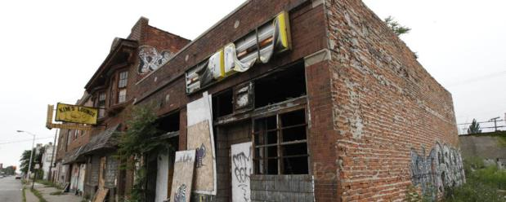
What is a brownfield?
For some incentives, a brownfield can also be a property that is
blighted
functionally obsolete
adjacent to a eligible property
historic
owned by a land bank

Slide 4
What is a brownfield?
Generally excludes residential and agricultural property
Notes:
Carrie
By statute, a “facility” does not include agricultural property where chemicals were applied consistent with directed use, or residential property.

Slide 5
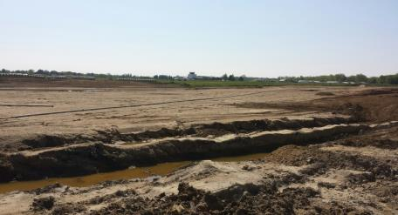
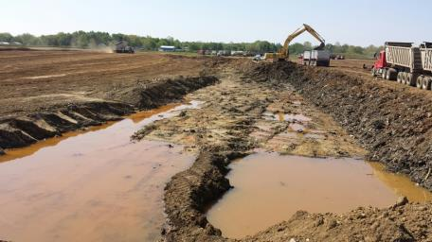
Brownfield Projects Near You
Jackson County Airport – Reynolds Field
Notes:
Carrie

Slide 6
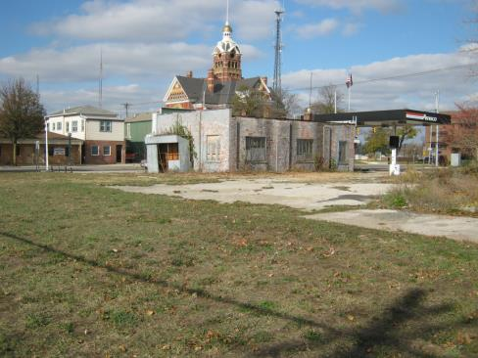
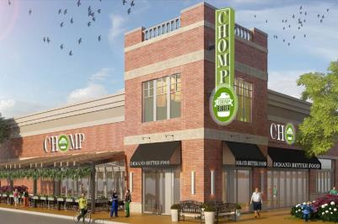
Brownfield Projects Near You
Dick’s Amoco / Chomp Burger - Adrian
Notes:
Carrie

Slide 7
Brownfields 101 Overview
Incentives
Responsibilities of a BRA
Redeveloping a Brownfield Property
Specific Property Discussions
Notes:
Carrie

Slide 8
Brownfield Staff
DEQ and MEDC staff work together with communities and brownfield authorities to redevelop brownfield sites
Notes:
Carrie

Slide 9
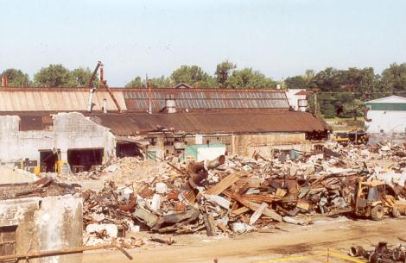
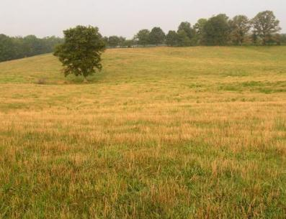
Leveling the Playing Field
Notes:
BRU staff
Goals of the Program: To ensure safe reuse of abandoned, vacant, or underutilized properties that are known to be contaminated, and to promote redevelopment of brownfields.
Grants
Loans
381 TIF, both DEQ and MEDC
Other grants and technical assistance
Criteria: A proposed project must result in economic benefit for the community greater than the amount of the grant through job creation, private investment, and/or property tax increase. The property must meet the definition of a facility under Part 201 of the Natural Resources and Environmental Protection Act, 1994 PA 451, as amended.

Slide 10
DEQ Brownfield Redevelopment Incentives
Grants
Loans
Act 381 Tax Increment Financing (TIF)
Notes:
BRU staff

Slide 11
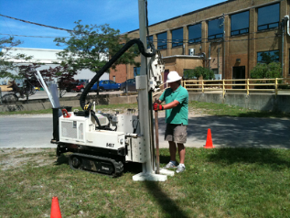
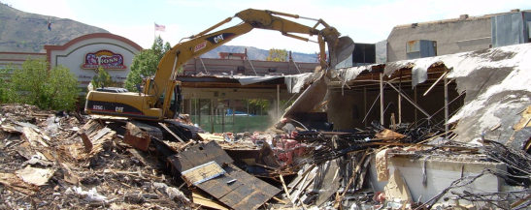
DEQ Brownfield Incentives
What’s Eligible?
Phase I, Phase II, BEAs
Due care
Additional response activities
In some instances, demolition
Notes:
BRU staff
Explain what a BEA is (brief)
Explain what due care is (brief)
Explain what additional response activities are (brief)
Demolition limited to no more than half the grant or loan amount
A liable party may not profit from the expenditure of state funds nor be relieved of responsibility for environmental response activities.
Liable party complicates but doesn’t disqualify from funding; C&E will talk about liability later
Grants and loans can pay for environmental costs at eligible sites- the conditions must be dealt with to allow for redevelopment and achieve environmental improvements and economic development (especially for grants). Eligible activities include environmental investigations and assessments, interim response, and due care response activities necessary for the proposed development.
We don’t generally consider buildings with lead paint or asbestos containing materials to be brownfield conditions from the perspective of environmental contamination. These conditions exist in many older buildings- they are eligible activities under the MSF part of Act 381 for school TIF reimbursement.
Basically, the DEQ is concerned with more typical environmental contamination- such as groundwater, soil or vapor intrusion issues where those would either increase the costs of development or have potential impacts on natural resources or future occupants of a building.
Eliminating or reducing the risks of contamination can be an eligible activity depending on the incentive used.

Slide 12
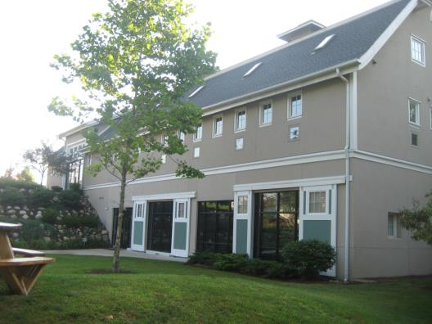
DEQ Grants and Loans
Applicant Annual Limits:
1 Grant of up to $1,000,000
1 Loan* of up to $1,000,000
Grants
Loans
TIF
*Loans:
1.5% rate
5 years payment & interest free
Old Sullivan Barn, Battle Creek
Notes:
BRU staff
Purpose: Brownfield redevelopment grants provide funding to local units of government and other public bodies to investigate and remediate known sites of environmental contamination, which will be used for identified economic redevelopment projects.
Dollar Amount(s) Available (Min or Max): Maximum grant award is 1 million dollars per project.
Only one project may be awarded to an applicant during any state fiscal year, but an applicant can receive both a Brownfield Redevelopment Grant and a Brownfield Redevelopment Loan in the same year.

Slide 13
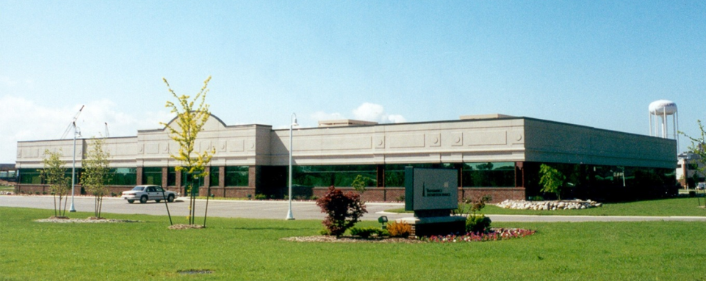
Who can apply for DEQ Grants and Loans?
Only local units of government :
A county, city, village, or township
A Brownfield Redevelopment Authority (BRA)
Another authority created under a county, city, township, or village
Notes:
BRU staff
Eligibility: Any county, city, village, township, Brownfield Redevelopment Authority, or other authority or other public body created pursuant to state law may apply for a grant. Applicants do not need to be BRAs

Slide 14
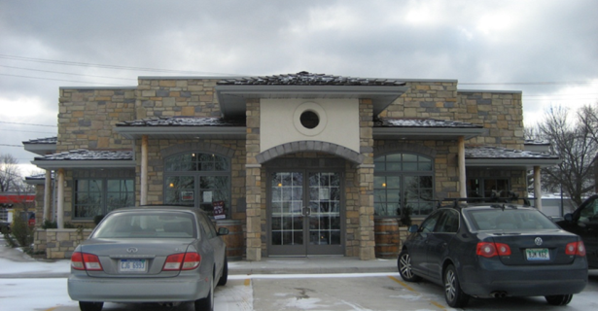
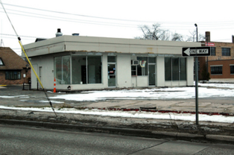
What is the local role in a grant/loan project?
Doesn’t have to own the property
Decide what projects are priorities in their communities
Apply for and administer grant/loan
Notes:
BRU staff
A pre-application must be requested from the Brownfield Redevelopment Unit. Pre-applications that meet threshold requirements may be invited to submit a full application, which are accepted on a continuing basis. Threshold requirements include: Evidence that the site is a facility, history of property use and ownership, a development agreement between the community and the developer, planning/zoning approvals, evidence of financing to complete the proposed project, and other pre-development information. Application evaluation criteria include: estimated private and public investment, applicant and owner liability, environmental benefit, and other factors.

Slide 15
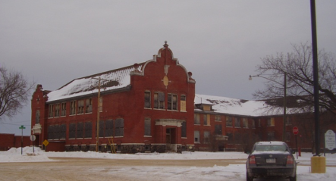
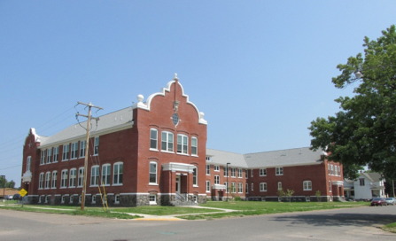
Tax Increment Financing It comes from the increase in property taxes paid when a property is redeveloped or improved.
What is Brownfield TIF?
Grants Loans TIF
Central School, Iron River
Notes:
BRU staff
Before we go any further, we wanted to cover what exactly Tax Increment Financing is and what it can do…

Slide 16
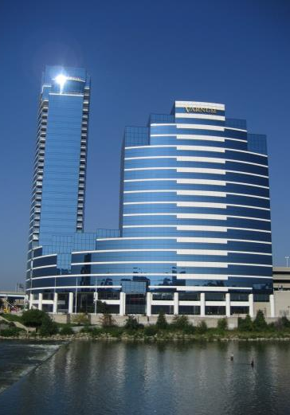
Brownfield TIF: How It Works
Only a brownfield redevelopment authority can authorize brownfield TIF
TIF does not exist until the property is improved and the taxes increase
The developer’s property taxes pay back eligible redevelopment costs
Bridgewater Place, Grand Rapids
Notes:
BRU staff
How it works:
Developer makes improvements to a property, which raises the taxable value and increases the tax revenue collected from the property.
The pre-redevelopment -or base value -remains as a revenue stream to the jurisdiction, the increased value or “increment” is captured by the jurisdiction to reimburse the developer for Brownfield eligible activities.
Win-win situation; developer is paid back for increased costs due to Brownfield conditions, jurisdiction gets increased tax values in the long run.

Slide 17
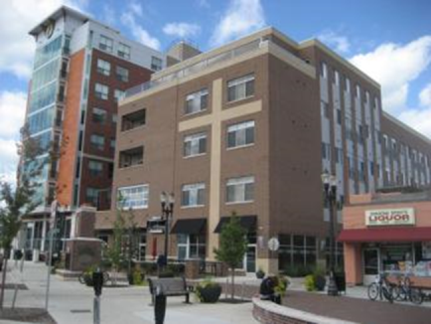
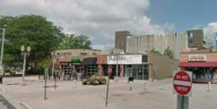
Brownfield TIF:
How It Works
Post-Development Value
Increment
Incremental
increase in
value –
this is the TIF
Initial
Value
St. Anne Lofts, East Lansing
Notes:
BRU staff

Slide 18
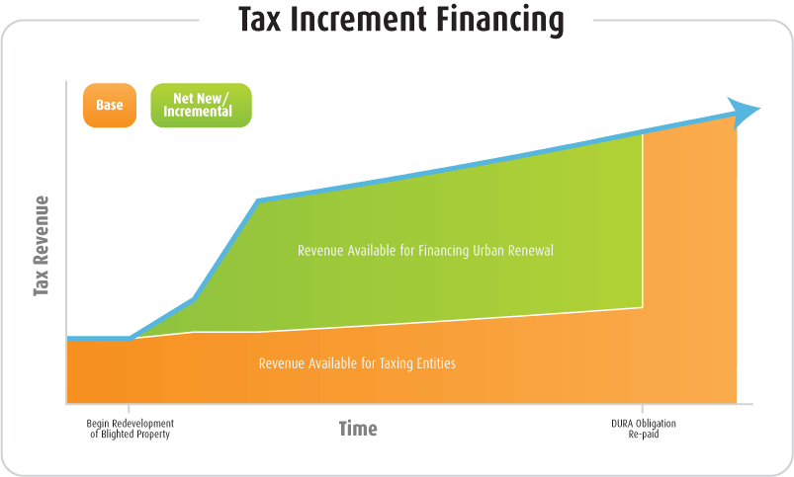
Brownfield TIF:
How It Works
Grants
Loans
TIF
Developer $$
$110
$10
Development
Begins
Developer
Repaid
Notes:
BRU staff

Slide 19
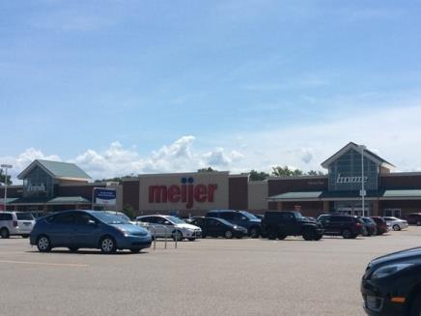
Brownfield TIF: How it works
Brownfield plan and Act 381 work plan approved and submitted by BRA
No limits on cost / number of work plans submitted
TIF repays developer or a brownfield loan
Meijer, Stevensville
Notes:
BRU staff

Slide 20
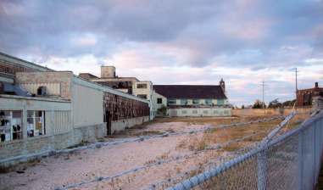
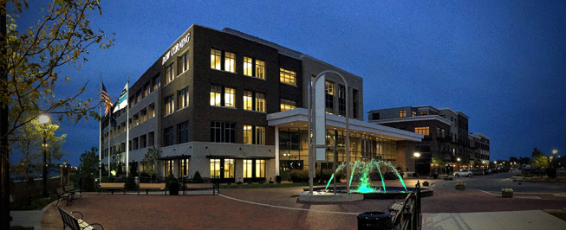
How is DEQ funding determined?
Package may include grant, loan, and/or TIF
Split between grants / loans negotiated with applicant
Uptown, Bay City
Notes:
BRU staff

Slide 21
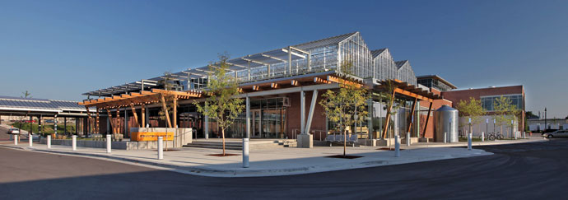
How is DEQ funding determined?
DEQ Grant: Requires private investment and job creation
DEQ Loan: Does not require a development
DEQ Act 381 TIF: Requires a developer or other upfront investor, but lowest threshold for DEQ approval
Downtown Market
Grand Rapids
Notes:
BRU staff
Grants are the most competitive and are typically awarded with a loan and/or TIF.
Loans are less competitive and are often awarded with TIF as repayment, but loans can be repaid from any source. While loans don’t require a developer, most loan projects have a developer so there’s a source of income to pay the loan.
Cannot use TIF for grant-funded activities

Slide 22
Where does TIF come from?
State school taxes (24 mills)
Local School Operating Tax (18 mills)
State Education Tax (6 mills)
Local taxes
Notes:
Rob
Act 381 allows Brownfield Redevelopment Authorities (BRAs) to capture state and local property taxes to pay for eligible activity costs
Projects capturing “local only” taxes do not require approval by MSF.
Local capture may also be utilized to pay portions of the BRA administrative, or other expenses.

Slide 23
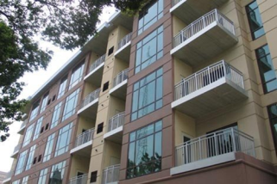
Where does TIF come from?
Must occur on eligible property that is included in a locally approved Brownfield Plan.
Debt millages are not allowed to be captured.
Does not take money away from schools, just defers increase
South University Village Studio One Apartments
Wayne State University, Detroit
Notes:
Rob

Slide 24
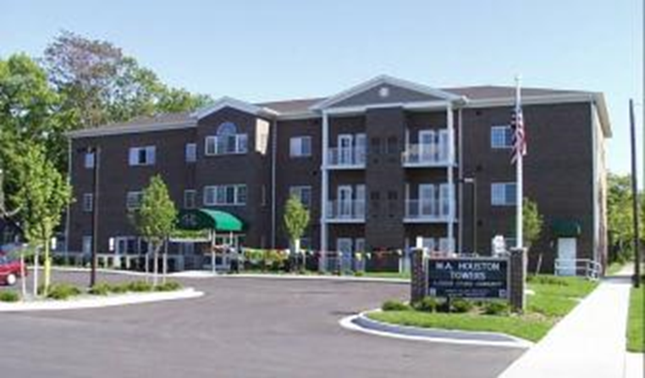
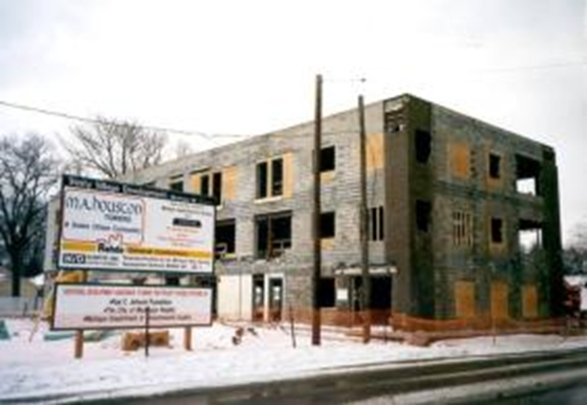
How do we get TIF?
A local unit of government can:
Create a local Brownfield Redevelopment Authority to direct incentives to brownfield sites
Work with the DEQ, MEDC, developers, consultants, others to redevelop brownfields
MA Houston Towers, Muskegon Heights
Notes:
BRU staff
Preparing brownfield sites for redevelopment requires knowledge of the potential sites, how they qualify, and the types of funding that may be available to address those conditions.
Another very important piece of being prepared is to ensure that the administrative processes are streamlined and clearly laid out for potential purchasers/developers. A screening process might also be utilized to affirm the prospective developer’s ability to complete the project.
Finally, the BRA should know the areas of town that are having improvements made to infrastructure- and compare these with known brownfield sites to determine the potential for redevelopment.

Slide 25
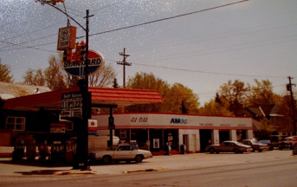
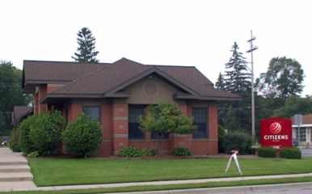
What can a BRA do?
Approve brownfield plans and TIF requests
Authorize TIF capture
Set maximum amount that can be captured
Apply for grants and loans
And more!
Citizens Bank, Traverse City
Notes:
Rob Garza or BRU staff
Act 381 allows Brownfield Redevelopment Authorities (BRAs) to capture state and local property taxes to pay for eligible activity costs.
Brownfield Redevelopment Authority-develops Brownfield Plan.
Must have Local or County approval of Brownfield Plan to authorize tax capture.
A County BRA must obtain concurrence for the TIF revenue capture from the affected city or township.

Slide 26
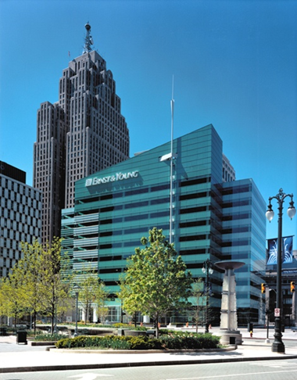
What else can a BRA do? LSRRF
Establish a Local Site Remediation Revolving Fund
Collect DEQ TIF
Fund eligible environmental activities
Notes:
Rob Garza or BRU staff
DEQ TIF revenues can be used to fund a local site remediation revolving fund (or LSRRF). MSF TIF may not be used for this purpose.

Slide 27
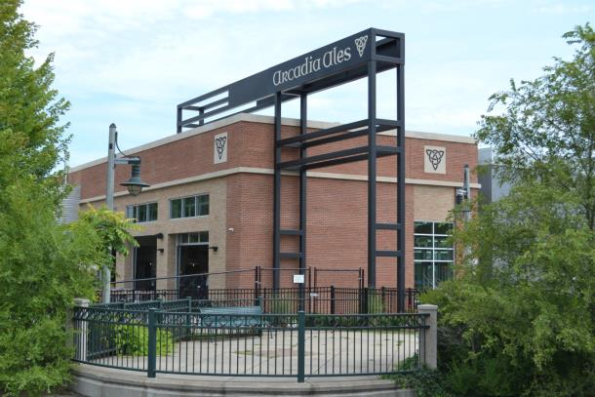
What property is eligible for brownfield TIF?
Property that is contaminated above state criteria:
DEQ can approve eligible activities ONLY at contaminated sites
Arcadia Ales, Kalamazoo
Notes:
Rob Garza or BRU staff

Slide 28
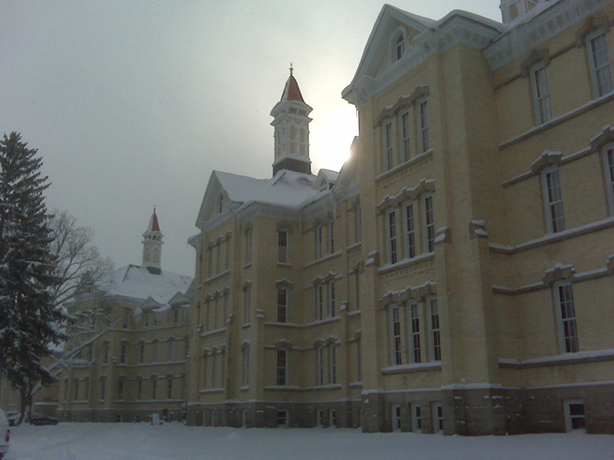
What property is eligible for brownfield TIF?
MEDC can approve TIF at property that is:
In a local historic district or is on State or National Register
Adjacent or contiguous to eligible property
Land Bank-owned (tax reverted) or Transit Oriented Development property
Blighted
Functionally Obsolete
Notes:
Rob Garza or BRU staff
Functionally Obsolete -- Unable to perform the function it was originally intended for (need level III or IV assessor).
Blighted -- Attractive nuisance to children, utilities permanently disconnected, fire hazard, subsurface debris
Designated by local government.
STAFF: Check to see if any communities attending the workshop are Core Communities.
QLGU designation determines available activities;
Core: All eligible activities.
Non-core: Lead & Asbestos Abatement and Demolition only.

Slide 29
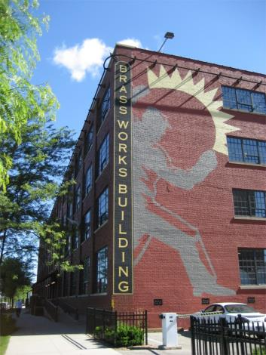
What can a BRA do? Preapproved Activities
Some environmental activities can be reimbursed with state TIF even without DEQ approval.
Site assessments
BEAs
Due care planning
Brassworks Building, Grand Rapids
Notes:
Rob Garza or BRU staff
Projects seeking the use of state school tax capture may undertake activities prior to Brownfield & work plan approval, but must include the activities in an approved plan prior to capture of TIR for reimbursement. Need BRA approval.

Slide 30
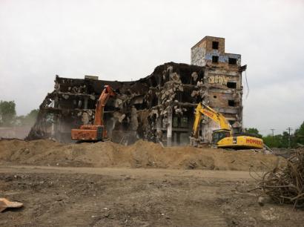
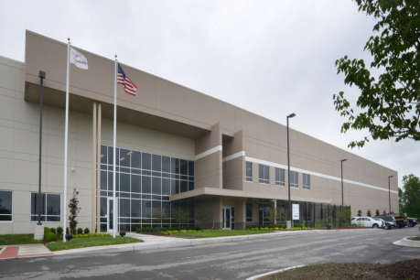
What can the DEQ approve?
DEQ approval is needed to use state school taxes for:
Due care
Additional response activities
Environmental Insurance
Notes:
Rob Garza or BRU staff

Slide 31
What can the MEDC approve?
MEDC / MSF approval is needed to use state school taxes for:
Building and Site Demolition
Lead & Asbestos abatement
Assistance to land banks and local governments
Infrastructure*
Site preparation*
* Currently approvable only to Core Communities
Notes:
Rob Garza or BRU staff
MSF/MEDC administers non-environmental portion of the Brownfield Redevelopment Program.
Includes redevelopment activities that are not related to contamination, but contamination may be present on the property.
MSF approves via Board resolution, or Board Chairperson approval if under $500,000.
Building and Site Demolition
Whole or partial buildings, interior or exterior
Old site infrastructure like concrete work, foundations, abandoned utilities, etc.
Lead and Asbestos Abatement
Assistance to a Land Bank or Local Government Unit.
Clearing title, purchase costs, acquisition for economic development purposes.
Infrastructure Improvements (Core Communities only)
Within public right-of-way or easement
Sewer & water, lighting, paving streets, etc.
Exception for stormwater management and parking decks on private land
Site Preparation (Core Communities only)
Prepares the site for development: clearing, soil removal and leveling, temporary facilities, etc.

Slide 32
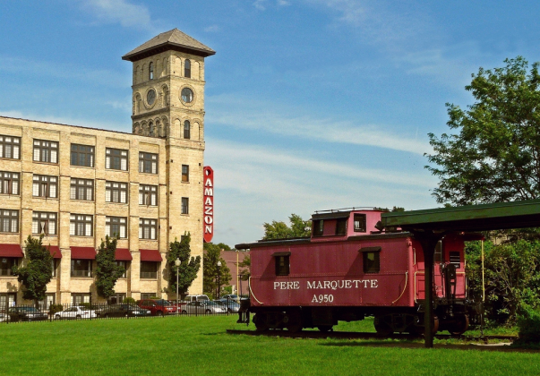
And one more thing…
Work plans must include 3 mills that are returned to the State Brownfield Redevelopment Fund for operational costs and a future brownfield projects
Amazon Building,
Muskegon
Notes:
Rob Garza or BRU staff

Slide 33
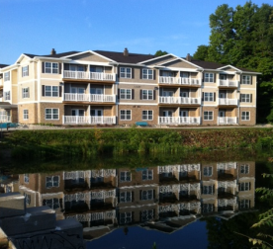
How does a BRA do a Brownfield Plan?
Brownfield Plan:
Developed by BRA
Describes the “eligible property”
Tells why it’s eligible
Affirms local jurisdiction support
Needs to include state and local TIF
Lake Pointe apartments, Hart
Notes:
Rob Garza or BRU staff
Brownfield Redevelopment Authority-develops Brownfield Plan.
Must have Local or County approval of Brownfield Plan to authorize tax capture.
A County BRA must obtain concurrence for the TIF revenue capture from the affected city or township.
The brownfield plan establishes the “eligible property” – Blighted, Functionally Obsolete, Contaminated, or owned by a Land Bank.
Describes the DEQ and/or MEDC eligible activities – environmental costs, site preparation, demolition, etc.
The plan shows that the community is committed to using its own TiF for redevelopment.
Finally, it sets both the base value of the property and the amount of TIF that will be allowed for reimbursement to the developer or the BRA itself- if it funded any activities.

Slide 34
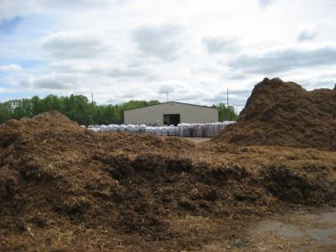
How does a BRA do a Brownfield Plan?
Before brownfield plan is adopted:
Submit a Public Hearing Notification to DEQ and MEDC
Hold a public hearing on the brownfield plan
Plan is approved by the governing body of the jurisdiction.
Mulch Manufacturing, West Branch Township
Notes:
Rob Garza or BRU staff
An authority that implements or modifies a brownfield plan that contains a qualified facility, the governing body (city, village, township, county) has to mail notices of the action to each taxing jurisdiction. A taxing jurisdiction can exempt its taxes from capture.
It’s best to contact the DEQ or MSF prior to finalizing any brownfield plans that will involve school tax capture and require agency approval of activities – before the public hearing is scheduled, but at any rate prior to any work plan being developed.
The authority also needs to submit the notice of the public hearing to the DEQ and MSF if the plan will involve any school tax capture.

Slide 35
How does a BRA do a Brownfield Plan?
LOCAL-ONLY Projects:
Local-only TIF projects need only to have a written brownfield plan
Plan is approved by the governing body of the jurisdiction
No work plan is needed
Notes:
Rob Garza or BRU staff
If the project only involves local taxes, the authority only needs to have a brownfield plan done. This also has to be approved by the local jurisdiction’s governing body. Projects capturing “local only” taxes do not require approval by MSF or DEQ.
Local capture may also be utilized to pay portions of the BRA administrative, or other expenses.

Slide 36
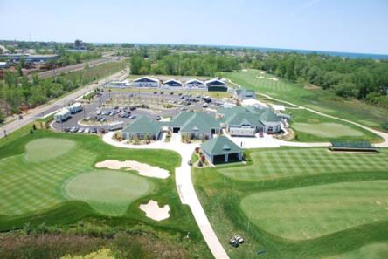
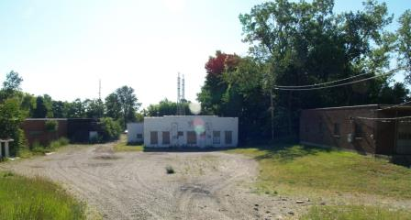
What’s in an Act 381 work plan?
381 Work Plan:
Includes specific eligible activities and cost details
Needs to include documentation to confirm the property is eligible
Harbor Shores, Benton Harbor
Notes:
Rob Garza or BRU staff
The work plan itself covers the specific activities that need to be conducted with more defined costs. The agencies approve the work plan activities if school TIF is involved.

Slide 37
How does a BRA do an Act 381 Work Plan?
Developer drafts Act 381 work plan for DEQ / MSF approval.
Developer consults MEDC/ DEQ before submitting work plan
BRA submits the work plan
MEDC and DEQ staff both review the project, but approve it separately.
Notes:
Rob Garza or BRU staff

Slide 38
Where are brownfield sites in my community?
Featured Online Services:
Inventory of Facilities
Leaking Underground Storage Tank Sites
Underground Storage Tank Sites
Michigan Environmental Mapper
www.michigan.gov/deq
Click on LAND
Notes:
Rob Garza or BRU staff
First, you will need to figure out where these known contaminated sites exist. You can start by working on the state’s databases, but your local or county planning/economic development departments or brownfield redevelopment authorities may have this information as well.

Slide 39
What other tools can I use?
Assessment grants: plan, inventory, prioritize and assess brownfields, conduct community involvement, and plan cleanup/redevelopment
Revolving Loan Fund grants: capitalize a revolving loan fund that provides loans and subgrants to clean up brownfield sites
Cleanup grants: remediate brownfields
EPA Brownfield Grants
Contact: Ron Smedley, DEQ-EPA Liaison
517-284-5153
SmedleyR@michigan.gov
Notes:
BRU staff

Slide 40
What other tools can I use?
Superfund site assessment: DEQ staff investigate sites with redevelopment potential that may be contaminated. Applications for 2017 available in October 2016
Contact: Joe Walczak, 517-284-5167 walczakj@michigan.gov
Other Department of Environmental Quality Resources
Notes:
BRU staff

Slide 41
What other tools can I use?
State grants, loans, and other assistance to support local placemaking at www.miplace.org. Click on Resources/Toolkit
Miplace.org
Notes:
BRU staff
MiPlace.org has almost every state grant / loan program listed along with its criteria. Some non-state resources are also listed. This is a really worthwhile tool for looking at most state funding sources in one place.

Slide 42
Questions? Ask us!
Jeff Hukill, Brownfield Redevelopment Coordinator, Michigan Department of Environmental Quality, 517-284-5113
hukillj@michigan.gov
Dan Gough, Brownfield Redevelopment Coordinator Michigan Department of Environmental Quality, 517-281-8253
goughd1@michigan.gov

Slide 43
www.michigan.gov/deqbrownfields

